Slide 1
Creating New Entities
November 14, 2014
Notes:
Guidewire training materials contain Guidewire proprietary information that is subject to confidentiality and non-disclosure agreements. You agree to use the information in this manual solely for the purpose of training to implement Guidewire software solutions. You also agree not to disclose the information in this manual to third parties or copy this manual without prior written consent from Guidewire. Guidewire training may be given only by Guidewire employees or certified Guidewire partners under the appropriate agreement with Guidewire.
<number>

Slide 2
Describe what is a custom entity and how to create a custom entity
Create entity elements and subelements that define fields, foreign keys, and arrays on entities
Identify entity related data elements associated with data model design
Notes:
<number>

Slide 3
Custom entities
Creating and defining an entity
Related data model elements
Notes:
<number>

Slide 4
Entities in applications
ClaimCenter
PolicyCenter
BillingCenter
Customers create custom entities and entity extensions
Application entities are specific to application
Platform entities are common to all Guidewire applications
Guidewire Platform
Notes:
The example above has three theoretical custom entities that could be added to each application, including:
A ClaimCenter MedCase_Ext entity, which stores custom medical information about an injury for which there is a legal dispute.
A PolicyCenter Trailer_Ext entity, which stores information about trailers that can be covered on Personal Auto policies.
A BillingCenter PhoneCall_Ext entity, which stores information about phone conversations that occur with payers on delinquent accounts.
Keep in mind that all three products have robust base applications that meet the needs that are common to most carriers. Custom entities are typically created to meet business needs that are not common to the majority of insurance carriers.
<number>

Slide 5
Entity files
ClaimCenter
PolicyCenter
BillingCenter
Customers can create custom entities
Entity (ETI)
Application
ETI
EIX
Platform
ETI
Guidewire Platform
Notes:
Platform entities are always found in the …\modules\configuration\config\metadata\entity\ folder. All ETI and EIX files in the \metadata\entity\ are read-only. You cannot edit these files directly in Guidewire Studio and should not edit these files in any other application.
Many platform entities have the platform="true" attribute defined in the <entity /> element. Ignore the deprecated base="true" or base="false" attribute in the <entity /> element.
Some application specific entities can also be found in the \metadata\entity\ folder. Many application entities are extendable in the sense that they can be both subtyped and/or an entity extension can be created. Entities with the final="true" attribute defined in the <entity /> element cannot be subtyped. Entities with the extendable="false" attribute defined in the <entity /> element cannot be extended in the sense that new elements cannot be added to the entity.
<number>

Slide 6
Custom entities and Gosu classes
configuration
application server
Building_Ext
Fields … NumberOfEmployees
InspectionDate HasParking…
database table row
abx_building
aBuilding_Ext
instance of Gosu class
read from database
save to database
Notes:
For a customer data model entity, the ETI file defines the fields. Custom entities are a single ETI file that customers can edit as needed. All of the fields in the custom entity's ETI file become a part of the internal Gosu class and a database table.
For custom entities, Guidewire recommends that the entity name should end with _Ext (or start with Ext), for example, Building_Ext as the name of the entity file. The names of the fields in the custom entity do not need to start or end with any prefix. Only use Ext in field names when extending an existing base application entity or creating new elements in an entity extension of a base application entity.
The name of the database table, however, is not building_ext, but rather, building. Guidewire creates a special prefix for extension entities by appending x to the two letter product code for the table name such as abx_building. The table name is an attribute of the entity xml element. When creating an entity, in the Entity dialog, you can remove the _ext from the table name.
Students coming from an Object-Oriented Programming (OOP) background should be aware that the term "extend" gets used in OOP differently than it does in Guidewire. In OOP, the term "extend" is used to refer to creating a new subclass that extends some parent superclass. In Guidewire data model configuration, the term "extend" is sometimes used to refer to adding new fields to an existing base application entity. In this sense, no new subclass or subtype entity is getting created. One is simply adding additional fields to an existing base application entity.
<number>

Slide 7
Custom entities
Creating and defining an entity
Related data model elements
Notes:
<number>

Slide 8
Steps to create a custom entity
Create the entity file
Add elements (and subelements) and specify attribute values
Optionally regenerate the dictionary
Deploy the custom entity
Notes:
<number>

Slide 9
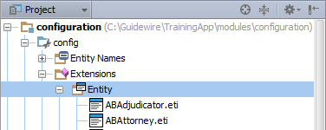
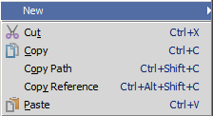
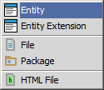
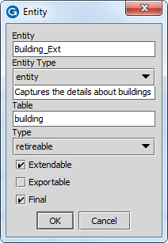
Step 1: Create the custom entity
In Project View, select ...\config\Extensions\Entity
Context menu → New → Entity
Entity dialog
25 character max length *
Use Pascal case ending with _Ext
Remove _Ext from table name
* See notes
Notes:
Guidewire recommends that the entity name should be in Pascal case. Pascal case is a style of capitalization in which multiple words are joined together with the first character of each word capitalized. Examples include the names "ClaimCenter" and "JavaScript". Pascal case is the naming convention recommendation for entities. Guidewire recommends ending the name of an entity with _Ext to distinguish the entity from base application entities.
In the entity dialog, you can also define the table name. In the majority of cases, you can keep the dialog defaults. However, by convention we remove the _Ext from table name since naming collision is avoided by the automatic prefixing <app>x as in the example: abx_building.
For loadable tables (ones that can be loaded through staging tables), the table name must be 25 characters or less. For non-loadable tables (ones that cannot be loaded through staging tables), the table name must be 26 characters or less. Some entities are supertypes to subtypes. Subtype entity names have a limit of 22 characters.
A retireable entity is an extension of the editable entity type, and is the most common type of entity. Most, but not all, base entities are of this type. Retireable means that entities of this type are never deleted. Entities of the type versionable can be deleted. Editable is not a recommended type. Instead, use versionable. Versionable entities have a version and an ID field. At application server start up, the Guidewire application loads all XML definitions of the data entities into the application database.
<number>

Slide 10
Optional <entity /> attributes
Extendable
Internal usage
Not needed for custom entities
Exportable
Deprecated support
Default = false
True allows for deprecated support to serialize entity for SOAP API and RPC-E web services
Final
Default = true
True means entity cannot be supertype of a subtype entity
Notes:
Extendable allows an entity to be extended and is for internal entities. If true, it is possible to extend this entity, which is something that is unnecessary to do for custom entities. Simply edit the custom entity.
If an entity is exportable, then all of its arrays must be exportable. All of the entity's arrays must point to other exportable entities. The application will not start if there is an exportable entity with one or more arrays pointing to non-exportable entities. Exportable entities support entity serialization which is required for deprecated RPC-E web services and the SOAP API.
The final attribute defaults to true. If true, you cannot subtype the entity. If false, you can define subtypes using this entity as the supertype.
<number>

Slide 11
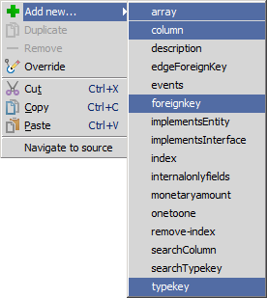
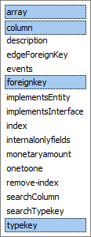
Step 2: Add elements and specify attributes
Toolbar
Select option in dropdown
Click + to add more of same
Context menu
Add new…
Select option in menu
Notes:
When creating elements, the Entity Editor refers to an Extensible Schema Definition (XSD) file, datamodel.xsd. The location of the file is <InstallRoot>\modules\configuration\xsd\metadata\datamodel.xsd. Not all elements define fields in a database, for example, <events />. Other elements are specific to database performance such as <index />.
The four primary elements listed above are common to entity extension (<extension>), entity declaration (<entity>), subtype extension (<extension>), and subtype declaration (<subtype>).
<number>

Slide 12
Common elements to add
Common elements (fields) for:
Entity extension, entity, subtype, subtype extension
<array …/>
Define array entity and field
<column …/>
Define data field with defined data type
Bit, datetime, integer, varchar
<foreignkey …/>
Define foreign key field and entity
<typekey …/>
Define typekey and related typelist
Do NOT create custom entity field names ending with _Ext
Notes:
The four primary elements listed above are common to entity extension (<extension>), entity declaration (<entity>), subtype extension (<extension>), and subtype declaration (<subtype>).
<number>

Slide 13
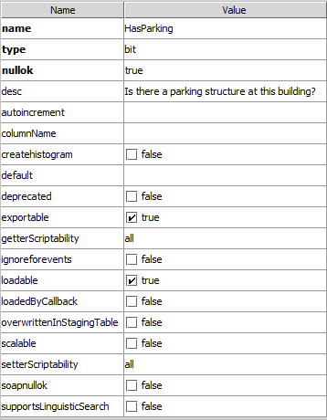
Entity editor: Attribute pane
Name Value columns
For selected element, define attributes
Schema aware values
Boolean controls
Dropdown lists
Attribute styling
Bold for required
Black for editable
Grayed-out for non-editable
Overridden, Inherited, Internal, Default
No default for nullok
Set to true in most cases
Notes:
<number>

Slide 14
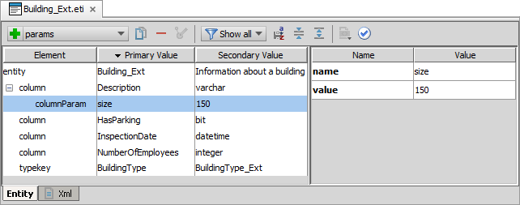
Add subelements
Use the toolbar to add a columnParam
Some elements require subelements based on the element and attribute definition and in many cases the subelements are optional
Add columnParam child element to a column of type varchar to specify size, e.g., varchar(60)
Notes:
You use the <columnParam> element to set parameters that a column type requires. The type attribute of a column determines which parameters you can set or modify by using the <columnParam> subelement.
You can determine the list of parameters that a column type supports by looking up the type definition in its .dti file. You can find the datatypes dti files in the datatypes folder in …\modules\configuration\config\datatypes\. For example, the varchar.dti files defines the possible parameters for the varchar column type.
The Entity Editor is schema aware and knows displays the available options for you when you select the type.
<number>

Slide 15
Step 3: Optionally regenerate dictionary
gwXX regen-dictionary
Process builds entire entity model including base and custom entities
Identifies errors in the data model beyond Entity Editor schema validation
C:\Guidewire\TrainingApp\bin>gwta regen-dictionary regen-entity-model-xml: ==================================================== = Running main class: com.guidewire.tools.dictionary.data.EntityModelXmlTool [java] --- Guidewire Entity Model In Xml --- … ERROR Errors found in Interaction_Ext ERROR ColumnIsValid - The column "Summary" on entity "Interaction_Ext" doesn't have column parameter "size" required for "varchar" data type." ERROR Property Summary : Required parameters missing: [size]
Notes:
You can also optionally regenerate the data dictionary to add the new entity to the data dictionary and to check for problems in the data model. Regenerating the data dictionary is not required, but doing so can identify flawed XML in the data model that go beyond schema validation such as certain types of referential integrity.
<number>

Slide 16
Step 4: Deploy the custom entity
Restart Server
bin command window
gwXX dev-stop
gwXX dev-start
Or, Guidewire Studio
Run → Stop
Run 'Server' or Debug 'Server'
During start-up
If autoupgrade=true in database-config.xml, then Guidewire attempts to upgrade the database according to the changes in the data model
Entity
Entity
Notes:
In Studio, the newly created entity is available to reference immediately. However, the entity is not available to the application server until the server is restarted and the database upgraded.
The automatic database upgrade process occurs only if the database autoupgrade=true attribute is defined in the database-config.xml.
TrainingApp uses an H2 database. Here is the XML definition found in database-config.xml:
<database name="TrainingAppDatabase" dbtype="h2" autoupgrade="true">
<dbcp-connection-pool jdbc-url="jdbc:h2:file:/Guidewire/TrainingApp/db/ta;auto_server=true"/>
</database>
For SQL Server and Oracle, this option is set to false by default.
<number>

Slide 17

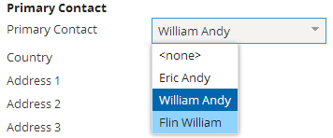
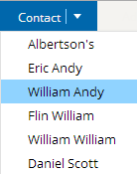
Entity names
Useful for displaying names in user interface
Explicit reference
List of objects
Define and configure entity names with the Entity Name editor
Internal class for entity contains DisplayName property
anABConctact.DisplayName
Notes:
Entity names are used when…
A) an object as a whole is displayed for example in dropdown that lists ABContacts.
B) an object's DisplayName is explicitly referenced for example, in an info bar widget with its value property set to ABContact.DisplayName.
The DisplayName field does not appear in the Data Dictionary. It is available on every entity, however.
<number>

Slide 18
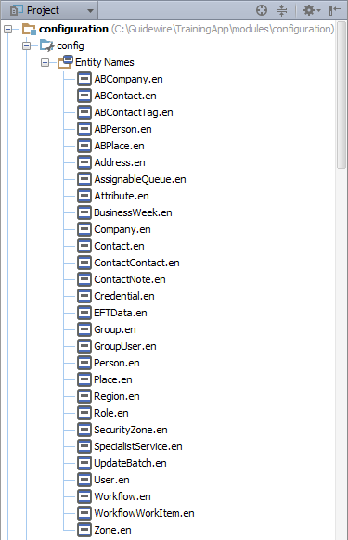
Entity Names
\configuration\ config\Entity Names
Physical folder is displaynames
Defined with Gosu code
Entity names exist for many base and application entities
For new entities displayed in the application user interface (UI), always create a default entity name
Edit with Entity Name Editor
Notes:
<number>

Slide 19
Custom entities
Creating and defining an entity
Related data model elements
Notes:
<number>

Slide 20
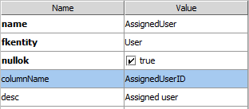
Foreign key
Pointer to single instance of some other entity
Maintained by foreign key column in database table
Example: each Contact can have one assigned user
Recommended naming convention
Include columnName attribute and set it to field name + ID
For extension, name field with suffix _Ext and column name _ExtID
Notes:
The columnName attribute is an optional attribute that specifies the actual name of the column in table created for this entity. This is useful when you want the database column name to differ from the field as referenced by Guidewire.
If a foreign key field is added to a base application entity, then the suffix should be _ExtID.
For a complete reference of the <foreignkey> syntax, refer to the application's Configuration Guide.
<number>

Slide 21
Array
Collection of pointers to instances of some other entity that is maintained by code during runtime
Requires reverse foreign key
If entity A has array of entity B, then entity B must have foreign key pointing to entity A
Example: each ABContact can have zero to many buildings
Recommended naming convention
Using plural form of name; For extension, name field with suffix _Ext
Notes:
Keep in mind that arrays are maintained in code. The code assembles the array by executing queries against the database. In order to do this, the application must be able to query for all members of a given array. It can do this only if each member has a foreign key referencing its parent.
Note that the value of the arrayentity attribute must match exactly the name of the entity it references.
<number>

Slide 22
One-to-one relationships
<onetoone> element defines a single-valued association to another entity that has a one-to-one cardinality
Provides a reverse pointer to an entity that is pointing at the <onetoone> entity through a foreign key
Often splits logical entity across multiple physical entities
Example:
ABContact defines Financial Summary as one-to-one
FinancialSummary defines a foreign key to ABContact
Notes:
A one-to-one relationship often splits a logical entity across multiple physical entities. For example, when an ABContact is a ABPolicyPerson or ABPolicyCompany, the data model must capture financial summary information.
Storing the financial summary details into the ABContact table would result in a table with numerous rows with null columns. Instead, it is better to have a separate entity manage the financial summary details. In this manner, every ABContact has (at most) one FinancialSummary, and every financial summary applies to (at most) one ABContact.
For more information on one-to-one relationships, refer to documentation.
<number>

Slide 23
Many-to-many relationships
Requires an entity of type versionable that represents the many-to-many relationship with the following:
Two or more non-nullable foreign keys
Unique index for all foreign keys
To access the many-to-many relationship, add an array to one or both entities in the relationship
Roles array in User specifies that there is zero or more UserRoles for a given user
Users array in Role specifies that there is zero or more UserRoles for a given role
Notes:
To add a many-to-many relationship between entity types to the data model, first create a separate versionable entity that represents the many-to-many relationship. (Versionable entities have a version and ID field an can be deleted as opposed to retireable entities which can never be deleted). Next, create foreign keys to each entity in the many-to-many relationship. Then add a unique index consisting of the foreign keys in the relationship.
Many-to-many relationships require a separate entity that contains the required foreign keys and a unique index for the foreign key values so that duplicate rows are not added to the table.
In order to access the many-to-many relationship values, one of the foreign key tables needs to specify an array entity. To access the relationship, add an array to one or both entities in the relationship.
In the slide example, the diagram does not represent the defined relationship in TrainingApp. In TrainingApp, UserRole is of the type joinarray. The joinarray entity type is an internal type and Guidewire does not recommend using this entity type. In addition, only User has a backing Roles array to UserRole.
For more information on many-to-many relationships and entities of type joinarray, refer to documentation.
<number>

Slide 24
Circular relationships
<edgeForeignKey> creates an edge table
OwnerID and ForeignEntityID columns
Links one entity to another or to self
Ensures the safe ordering of data insertion and deletion in cases where cyclic references prevent safe ordering
Examples:
Child references parent
Reference between subtypes
Notes:
In some cases, an entity needs to refer to itself. This could occur both for a non-subtyped entity (every Group has a parent group) or a subtyped entity when one subtype refers to another (every ABCompany—which is an ABContact—can have a finance manager who is an ABPerson, which is also an ABContact). The Guidewire data model does not let an entity reference itself, or two or more entities reference one another in a cyclical manner, using only foreign keys. This is because Guidewire cannot easily determine the order in which rows can safely be written to the database when a data model cycle exists.
To solve this kind of circular dependency between foreign keys, Guidewire recommends that you use an edge foreign key (<edgeForeignKey>). An edge foreign key from A to B introduces a new, hidden entity that has a foreign key to A and a foreign key to B. However, it does not create any direct foreign key from A to B. As such, ClaimCenter can safely commit the A objects first, then the B objects, and finally, the hidden A/B edge foreign key entities. This ensures that the relationship information does not reference non-existent rows. The same principal is true for two or more entities that reference one another in a cyclical fashion. The cycle can be implemented using an edge foreign key, which allows all the individual rows to be written first, and the relationships among the rows to be written afterwards.
For more information on edge foreign keys and circular references, refer to documentation.
<number>

Slide 25
Delegates
A delegate is a virtual entity consisting of database fields, or methods, or both that can be reused by multiple entities
Assignable
Assignable
Activity
ContactNote
Assignable
Status Escalated AssignedUser AssignedGroup
Subject NoteType AssignedUser AssignedGroup
AssignedUser AssignedGroup
delegate
entities implementing delegate
Bundle together data and functionality that is needed by multiple unrelated entities
<implementsEntity /> implements existing delegates
<delegate /> to create new delegate
Notes:
Guidewire offers at least three different features for sharing functionality across the data model: delegates, subtypes, and interfaces. A delegate is designed for situations where multiple entities need common functionality but are distinctly different.
Delegates are often used over subtypes because subtyping can be impractical. The entities in question share only a small set of fields in common and it would be impractical to store them in a single table. You might also need to give one entity delegate A, another delegate B, and a third delegates A and B. Subtyping would require all these entities to be in a single table.
Delegates are often used over interfaces because interfaces do not define database fields.
You can add a delegate to an entity by using the implementsEntity element. Specify the delegate for the name value attribute.
For more information on delegates, refer to documentation.
<number>

Slide 26
Describe what is a custom entity and how to create a custom entity
Create entity elements and subelements that define fields, foreign keys, and arrays on entities
Identify entity related data elements associated with data model design
Notes:
<number>

Slide 27
What is the difference between an ETX file and an ETI file?
Does the base application have ETI files? Can developers create new ETI files? Where and how?
If the ABLawyer entity has an array of Cases, what type of field is required on the Case entity?
To deploy data model changes, are you required to:
Regenerate the Data Dictionary?
Restart the application server?
Restart Studio?
Notes:
Answers
1) An ETX file contains an <extension> element and extends a base application entity. An ETI file contains an <entity> element and defines a new entity.
2) Yes, ETI files are in the base application. Developers can create new ETI files in the …\extensions\entity\ folder using Guidewire Studio and the Entity Editor.
3) The Case entity requires a foreign key element (field) in the ETI definition that specifies the fkentity attribute as the ABLawyer entity.
4a) You are not required to regenerate the data dictionary. Regenerating the data dictionary will identify any errors in the data model. If successful, the process will add new and modified entities to the data dictionary.
4b) Yes, you must restart the application server to deploy the new and modified entities. The process creates new database tables and or upgraded the database. Internal Gosu classes are also created and modified. 4c) Studio is immediately aware of the data model changes. It is not necessary to restart Guidewire Studio.
<number>

Slide 28
Notes:
<number>

